Slide 1
QT
QObject base class.
Adds features like:
Signals and slots
Properties
Event Handling
Memory Management
Meta-Object system
Qobject has no visual representation

Slide 2
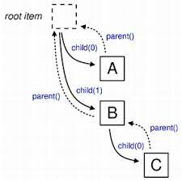
Object Tree
Every object has a parent that owns it
Last parameter
Cannot copy a QO
Construction
Destruction
PARENT CHILED
RELATION IS NOT
INHERITANCE

Slide 3
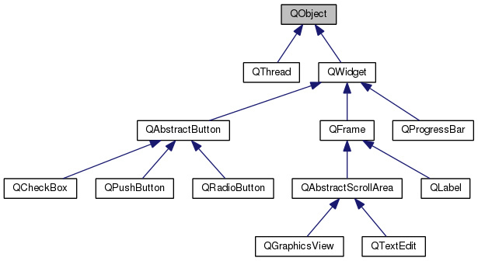
QWidget

Slide 4
QWidget
Recived events
Widgets also have hierarchy structure
QWidget parents own children.
If a parent is removed, or disabled, all of his children will be removed too.
New QWidget(0): widget with no parent window

Slide 5
Signal And Sots
Object Communication:
Signal: emitted to notify other objects
Slot: method called in response to signal
Used instead of callbacks
Easier to use
More secure
More flexible
Has to be generated
Meta Object

Slide 6
Events
GUI applications are event driven
Qapplication::exec() runs the event loop
Generate Events: keyboard, timer,…
Queue Events: by event loop
Dispatch Events: every event has a receiver
Handle Events: by Qobject even handlers

Slide 7
Events
QWidget has a lot of event handlers for mousePressEvent or keyPressEvent
Accepting an Event
event-> accept() / event->ignore()
Accept is the default
Event Propagation
If event is ignored
Propagated up in the object tree

Slide 8
Events and Signals
Events are 1 to 1, signals and slots are m to n
Signals and Slots can be used instead of events
Custom events can be created
Signals usually have some semantic meaning for application
Events are something that happens spontaneously physically in the application

Slide 9
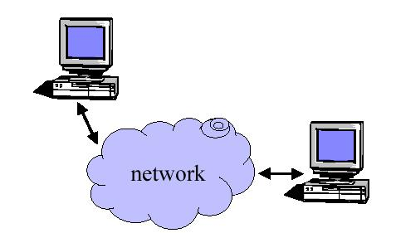
Why do we need sockets?
Provides an abstraction for interprocess communication

Slide 10
Functions
  Define an “end- point” for communication
  Initiate and accept a connection
  Send and receive data
  Terminate a connection gracefully
Examples
  File transfer apps (FTP), Web browsers
  (HTTP), Email (SMTP/ POP3), etc…

Slide 11
Types of Sockets
Two different types of sockets :
  stream vs. datagram
Stream socket :( a. k. a. connection- oriented socket)
  It provides reliable, connected networking service
  Error free; no out- of- order packets (uses TCP)
  applications: telnet/ ssh, http, …
Datagram socket :( a. k. a. connectionless socket)
  It provides unreliable, best- effort networking service
  Packets may be lost; may arrive out of order (uses UDP)
  applications: streaming audio/ video (realplayer), …

Slide 12
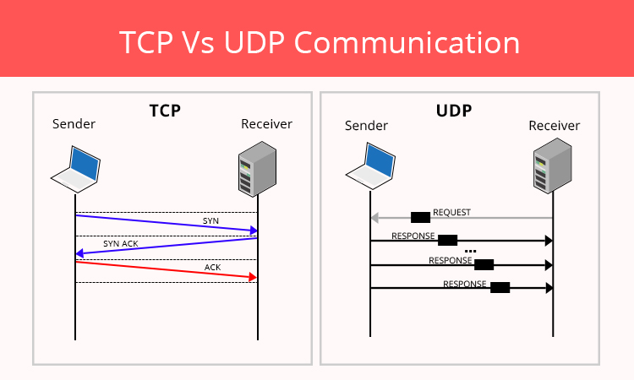

Slide 13
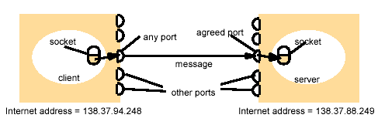
Addressing
Client
Server

Slide 14
IP Addresses, Ports and Sockets
Like apartments and mailboxes
  You are the application
  Your apartment building address is the address
  Your mailbox is the port
  The post-office is the network
  The socket is the key that gives you access to the right mailbox

Slide 15
Server – high level view
Create a socket
Bind the socket
Listen for connections
Accept new client connections
Read/write to client connections
Shutdown connection

Slide 16
Client – high level view
Create a socket
Setup the server address
Connect to the server
Read/write data
Shutdown connection

Slide 17
socket()
TCP Server
bind()
Well-known port
TCP Client
listen()
Socket()
accept()
connect()
Connection establishment
blocks until connection from client
write()
Data(request)
read()
process request
Data(reply)
write()
read()
close()
End-of-file notification
read()
close()

